Slide 1
John Kanagaraj
DB Soft Inc
Expert Session #260
Your tuning arsenal: AWR, ADDM, ASH, Metrics and Advisors

Slide 2


Speaker Qualifications
John is a Principal Consultant @ DB Soft Inc.
Executive Editor for IOUG’s SELECT Journal
Co-author of “Oracle Database 10g Insider Solutions”
Technical Editors for various books
Frequent presenter – IOUG/OAUG/OOW
Published in SELECT, OAUG Insight, SQL Server Magazine

Slide 3

SELECT: Call for Articles/Reviewers
  Distributed to all IOUG members worldwide
    Submit an article or Review one!
    Contact ‘select@ioug.org’

Slide 4
What this presentation is about
Tuning tools in Oracle 10gR2
AWR, ADDM, ASH, Metrics, Advisors
Look “Under the hood”
Real life Examples
Audience Survey: Use of GUI tools, DB Console, Grid Control

Slide 5
Philosophy behind Oracle DB 10g
“Automation”
  Incremental steps in 9i (Advisors, Time)
  Major changes in many areas
  Most significant change in Performance management
  “Out of the box” setups
  GUI “hides” the complexity (and details!)
Notes:
Many architectural changes have been made to automatically improve memory handling, resource management, storage provisioning, SQL tuning, data movement, recovery speed, and globalization

Slide 6
Previous status
DB never lacked perf. statistics
Then what was lacking?
  Consistency
  Common/Unified interface
  Stats storage and presentation
  Interpretation

Slide 7
Now in Oracle DB 10g….
Performance Management
  Consistency (AWR)
  Interface (DB Console/Views)
  Storage/Presentation (AWR/DBC)
  Interpretation (Advisors)
Builds on previous concepts!
HOWEVER (!!) – Check licensing

Slide 8
“OWI” - The “Wait” interface
OWI – Term never acknowledged
“What is the session waiting for?”
Rolls up session/system level
Ignores the “CPU” component
Well understood (after many years!)

Slide 9
The basics – Session State
Session State:
  Starting up or shutting down
  Executing on the CPU
  Waiting in the CPU queue to execute
  Waiting for an event external to the process to complete (OWI)

Slide 10
An earlier realization
Oracle recognized this
Look at a STATSPACK report
  “Top 5 Wait Events” – 8i/9iR1
  “Top 5 Timed Event” – 9iR2 (and 10g)
CPU stats from V$SESSTAT and V$SYSSTAT

Slide 11
Time Model in 10g
V$SYS_TIME_MODEL – System
V$SESS_TIME_MODEL – Session
Some values are roll-ups of others
E.g. “DB Time” => “DB CPU” + Connection management time + Parse time + (others)
Extremely valuable (V$SESSTAT++)

Slide 12
SQL> select stat_name, value from v$sys_time_model
2 where value > 0;
STAT_NAME VALUE
--------------------------------------------- --------------
DB time 893170091346
DB CPU 176244910473
sequence load elapsed time 10215471781
parse time elapsed 4524012412
hard parse elapsed time 3657262901
failed parse elapsed time 103540062
hard parse (sharing criteria) elapsed time 365217641
hard parse (bind mismatch) elapsed time 5923514
repeated bind elapsed time 14768010
connection management call elapsed time 328536127
PL/SQL execution elapsed time 5554924592
PL/SQL compilation elapsed time 333815896
background elapsed time 13782131027
background cpu time 4572399582
Zero values for statistics such as ‘Java execution elapsed time’

Slide 13
Wait Classes in 10g
From 100 events (7.3.4) to 874 (10.2)!
10g classified events under “Wait Class”
Rollup in V$SYSTEM_WAIT_CLASS
Complete set in V$EVENT_NAME
New WAIT_CLASS column in various “wait” views (system and session level)
Notes:
Available in V_$SESSION, V_$SESSION_WAIT_CLASS, V_$SESSION_WAIT, V_$SESSION_EVENT, V_$SYSTEM_WAIT_CLASS, V_$SYSTEM_EVENT, V_$EVENT_NAME, V_$SERVICE_WAIT_CLASS, V_$ACTIVE_SESSION_HISTORY, WRH$_EVENT_NAME, WRH$_SERVICE_WAIT_CLASS, WRH$_SERVICE_WAIT_CLASS_BL, DBA_HIST_EVENT_NAME, DBA_HIST_SYSTEM_EVENT, DBA_HIST_BG_EVENT_SUMMARY, etc.

Slide 14
SQL> select wait_class, sum(time_waited) from v$system_event
group by wait_class order by sum(time_waited) desc;
WAIT_CLASS SUM(TIME_WAITED)
------------------------------ ----------------
Idle 1167524793
User I/O 50076396
Application 23244155
System I/O 544713
Concurrency 462203
Network 44112
Other 11973
Commit 11021
Configuration 5736
SQL> select wait_class, name from v$event_name
3 where wait_class in ('System I/O','Concurrency') order by wait_class, name;
WAIT_CLASS NAME
------------------ ------------------------------------------------------------
Concurrency buffer busy waits
Concurrency enq: TX - index contention (** Enqueue type broken out!**)
Concurrency latch: cache buffers chains (** Latch type broken out!**)
Concurrency latch: library cache
Concurrency os thread startup
System I/O LGWR sequential i/o
System I/O control file parallel write
System I/O recovery read
Notes:
Event breakout: 29 different types of latching and the ‘enqueue’ event breaks out into an amazing 208 types!

Slide 15
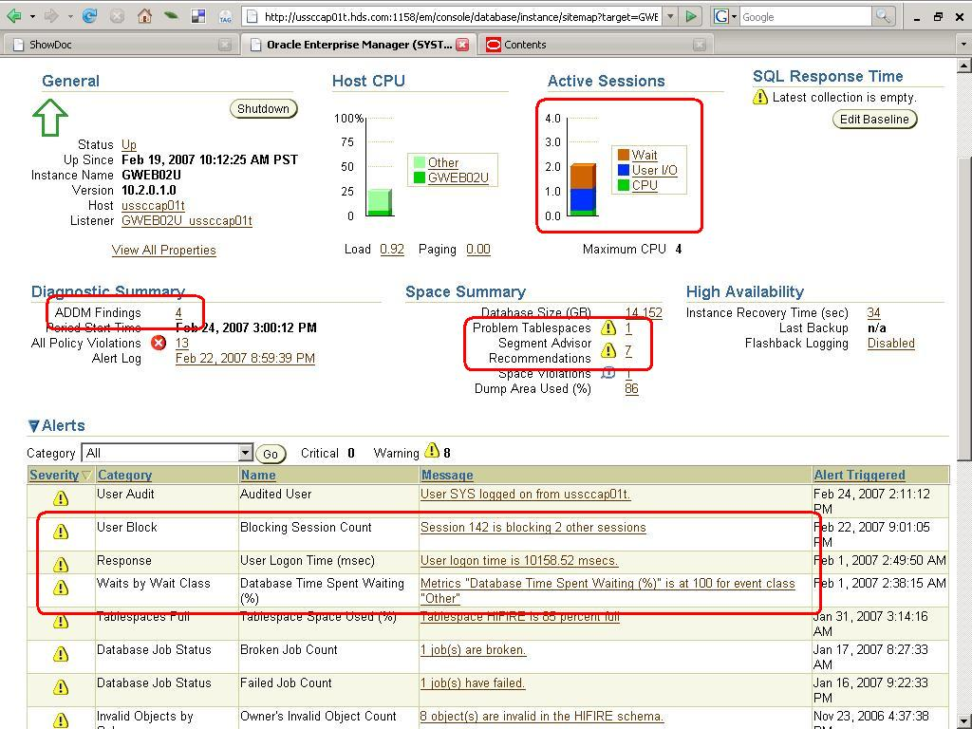
Front page news – DB Console

Slide 16
Automatic Workload Repository
Performance Data Warehouse for 10g
AWR collects, stores performance data
  In-memory component (V$/Metric views)
  “Persisted” in WR tables (SYSAUX)
  162 tables – WRI$, WRH$, WRM$
Self managing “out of the box”
Set retention, frequency, baseline
Notes:
WRM$_WR_CONTROL – management, WRH$_ACTIVE_SESSION_HISTORY – History, WRI$_ADV_REC_ACTIONS – Interpretation and results

Slide 17
Automatic Workload Repository
Active Session History (ASH)
High-load SQL statements
Time model statistics (both System/Session)
Object usage - access counts for segments
Snapshots of V$ and some Metrics

Slide 18
AWR – “Statspack on Steroids”
Similar to STATSPACK “snapshots”
Reportable – AWRRPT.SQL
AWR snapshot automatically analyzed
Accessible via GUI and API/SQL (*)
High-impact SQL captured differently
Stores session level info as well
Notes:
Knowing and reporting off STATSPACK data – extend to 10g

Slide 19
AWR – Storage in SYSAUX
SQL> select occupant_name, occupant_desc, space_usage_kbytes
2 from v$sysaux_occupants
3 where occupant_name like 'SM%‘;
Name Description Used KB
---------- ---------------------------------------------------- ------
SM/AWR Server Manageability-Automatic Workload Repository 200192
SM/ADVISOR Server Manageability-Advisor Framework 39104
SM/OPTSTAT Server Manageability-Optimizer Statistics History 102912
SM/OTHER Server Manageability-Other Components 9472
Overheads of AWR – Storage, Collection, Archive log usage, latching
Metalink Note 296765.1

Slide 20
AWR Baselines
Enables performance “baselining”
Collection of two or more snapshots
Stored in “_BL” tables; data retained
View using WRM$_BASELINE
Reports diff via AWRDDRPT.SQL
Can also be used with SQL Tuning Sets

Slide 21
API - DBMS_WORKLOAD_REPOSITORY
Scripts in $OH/rdbms/admin
  awrrpt.sql AWR report (STATSPACK)
  awrddrpt.sql AWR Diff-Diff report
  awrextr.sql frontends a DataPump dump
  awrinfo.sql Space usage by AWR/ASH
  awrsqrpt.sql Execution statistics for specific SQL statement

Slide 22
ASH – What’s up with sessions
Historical view of active sessions
V$ACTIVE_SESSION_HISTORY
Active sessions sampled every second
Stored in circular memory buffer
Every 10th sample persisted in AWR
Enables “after-the-fact” analysis!!!
Notes:
Persisted in the WRH$_ACTIVE_SESSION_HISTORY

Slide 23
ASH – Session states exposed!
“On-the-spot” analysis
Retroactive analysis
  From memory buffer (V$ACTIVE_SESSION_HISTORY)
  From persisted AWR data (WRH$_ACTIVE_SESSION_HISTORY connected via SNAP_ID)
High load SQL execution behavior
Determine Blocking sessions and “hot” segments
SESSION_STATE : “ON CPU” or “WAITING”

Slide 24
ASH – What is happening to me?!
SQL> select event, seq#, p1, p2, p3, blocking_session
2 from v$active_session_history
3 where session_id = 113 and session_serial# = 333;
EVENT Seq# P1 P2 P3 BlkSess
---------------------------- ------- ------------ ------------ ------------ -------
db file sequential read 34786 29 182279 1 0
db file scattered read 34870 19 103899 8 0
db file sequential read 34954 29 183370 1 0
db file scattered read 35040 19 102299 8 0
enq: TX - row lock contention 35119 1415053318 524322 11255 142
db file scattered read 35204 19 99643 8 0
db file scattered read 35207 19 102371 8 0
enq: TX - row lock contention 35220 1415053318 524322 11255 142
db file scattered read 35232 19 100019 8 0
enq: TX - row lock contention 35243 1415053318 524322 11255 142
db file scattered read 35256 19 102747 8 0

Slide 25
ASH Report - New in 10gR2
Summary of all user activity over the selected period
Drill down to a more granular period
List details of only a Session, SQL ID, Wait Class, Service, Module or Client ID over a particular period
“Top” Background events, P1-P3 values, etc.
$OH/rdbms/admin/ashrpt.sql + GUI

Slide 26
Activity Over Time
-> Analysis period is divided into smaller time slots
-> Top 3 events are reported in each of those slots
-> 'Slot Count' shows the number of ASH samples in that slot
-> 'Event Count' shows the number of ASH samples waiting for
that event in that slot
-> '% Event' is 'Event Count' over all ASH samples in the analysis period
Slot Event
Slot Time (Duration) Count Event Count % Event
-------------------- -------- ------------------------------ -------- -------
19:50:18 (42 secs) 86 enq: TX - row lock contention 43 8.10
db file scattered read 39 7.34
CPU + Wait for CPU 4 0.75
19:51:00 (1.0 min) 119 enq: TX - row lock contention 58 10.92
db file scattered read 50 9.42
CPU + Wait for CPU 11 2.07
19:52:00 (1.0 min) 126 enq: TX - row lock contention 60 11.30
db file scattered read 50 9.42
CPU + Wait for CPU 13 2.45
19:53:00 (1.0 min) 123 enq: TX - row lock contention 59 11.11
db file scattered read 49 9.23
CPU + Wait for CPU 15 2.82
19:54:00 (38 secs) 77 enq: TX - row lock contention 37 6.97
db file scattered read 36 6.78
CPU + Wait for CPU 3 0.56

Slide 27
ASH - Others
Underscore parameters (last 2 new in 10gR2)
  _ash_enable (Enable ASH?)
  _ash_disk_filter_ratio (inmemory to flush -10)
  _ash_eflush_trigger (emergency flush 66% by default)
  _ash_sampling_interval (1 second)
  _ash_disk_write_enable (enable ASH history flushing to disk)
  _ash_sample_all (sample everything including inactive sessions)
ASH Dump – Metalink Note 243132.1

Slide 28
ADDM – Your unpaid Tuning Expert!
Starting point for most investigations
Runs after every AWR snapshot
Determines and records performance issue
Recommends corrective action
Generates probable benefit
Suggest use of other advisors
Common currency - “DB Time” (qualitative!)

Slide 29
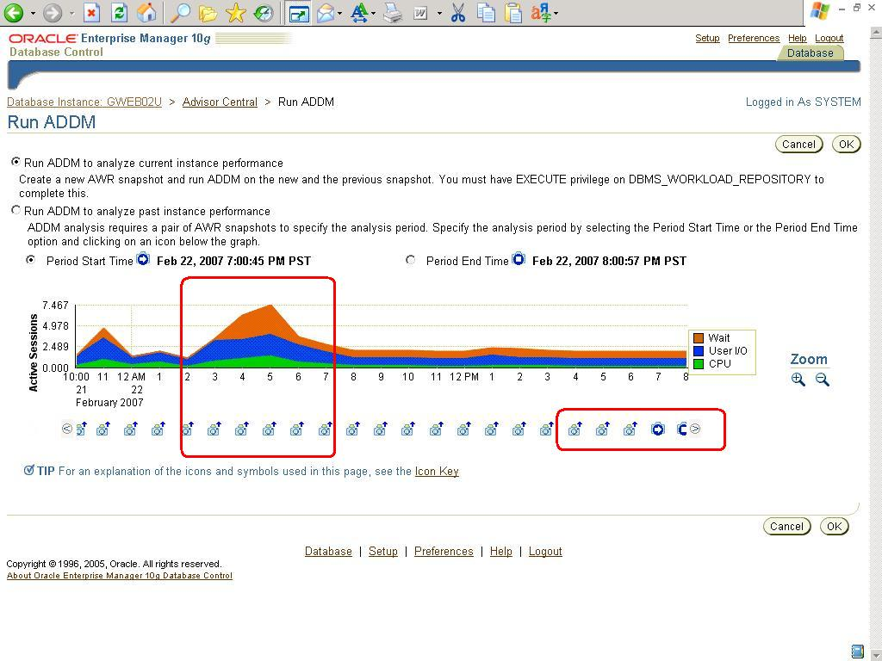

Slide 30
ADDM checks for: (partial list)
CPU bottlenecks
Excessive parsing
Lock contention
Concurrency
I/O capacity
Incorrect sizing of Oracle memory and file structures
High-load SQL, Java and PL/SQL statements
Poor connection management
Hot objects
RAC-specific issues

Slide 31
ADDM – Findings/Recommendations
Hardware changes
Database-configuration changes
Schema-level changes
Application changes
Using other advisors (for example)
  SQL Tuning / Access Advisor
  Segment Advisor

Slide 32
ADDM – Accessing “ADDuM”
GUI! (easiest because of linkage)
$OH/rdbms/admin/addmrpt.sql
API – DBMS_ADVISOR In-built PL/SQL
Look at following tables
  DBA_ADVISOR_LOG
  DBA_ADVISOR_FINDINGS
  DBA_ADVISOR_RECOMMENDATIONS
  DBA_ADVISOR_ACTIONS
  DBA_ADVISOR_RATIONALE

Slide 33
ADDM – Don’t stare at the screen!
SQL> select type, count(*) from dba_advisor_findings
where task_id in
(select task_id from dba_advisor_log
where execution_start > sysdate - 1)
group by type;
TYPE COUNT(*)
----------- --------
INFORMATION 46
WARNING 1
SYMPTOM 49
PROBLEM 79

Slide 34
ADDM – Don’t stare at the screen!
SQL> select count(*) count, message from dba_advisor_findings
where task_id in
(select task_id from dba_advisor_log
where execution_start > sysdate - 1)
and type = 'PROBLEM‘ group by message order by 1 desc;
COUNT MESSAGE
----- ----------------------------------------------------------------- 24 SQL statements consuming significant database time were found.
24 SQL statements were found waiting for row lock waits.
24 Individual database segments responsible for significant user I/O wait were found.
4 The execution plan of this statement can be improved by creating one or more indices
1 PL/SQL execution consumed significant database time.
1 Significant virtual memory paging was detected on the host operating system.
1 The throughput of the I/O subsystem was significantly lower than expected

Slide 35
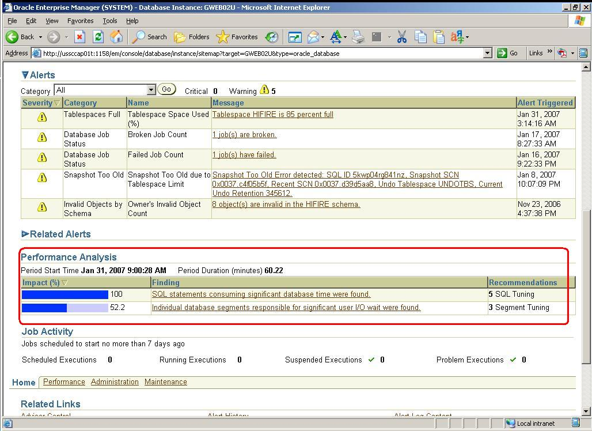

Slide 36
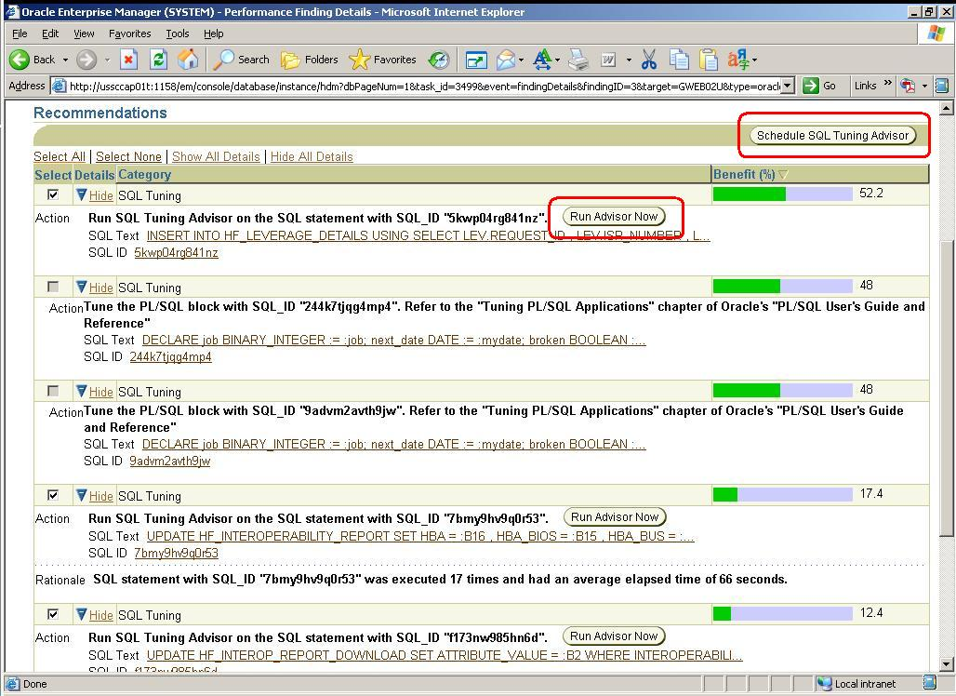

Slide 37
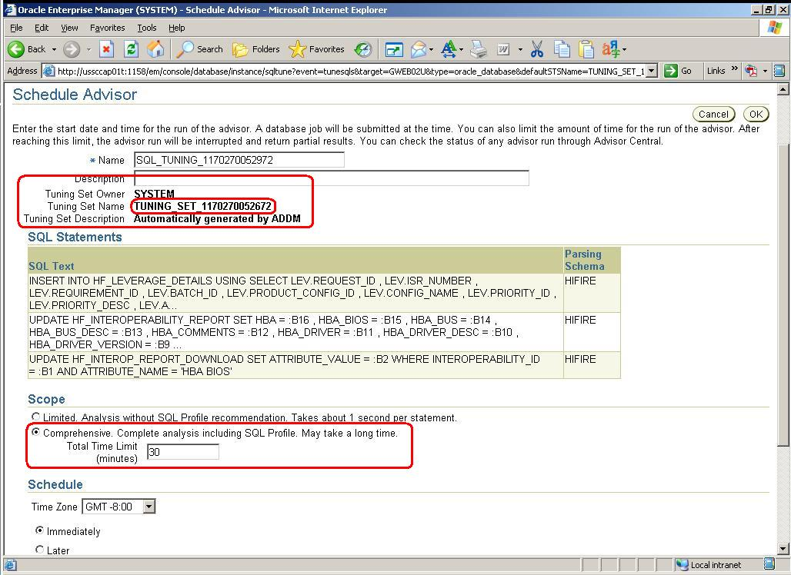
Notes:
Note the Total Time (30 minutes) – Remember there were only 3 SQL statements selected for tuning, and all of them appear here

Slide 38
Advisors – More freebies!
9i – Buff. Cache, Summary, ShPool, etc
New in Oracle Database 10g
  SQL Tuning Advisor
  SQL Access Advisor
  Segment Advisor
  Redolog sizing Advisor
  Undo Advisor
Notes:
Other 9i – MTTR, PGA Aggr Target

Slide 39
Advisor Framework
Ensures consistency and uniformity
  Access (GUI, API - DBMS_ADVISOR, DBMS_SQLTUNE)
  Storage (Collection, AWR)
  Invocation (easily and seamlessly between each other)
  Parameterization (WR%ADV%PAR%)
  Reporting (Common tables and API)
Notes:
Other 9i – MTTR, PGA Aggr Target

Slide 40
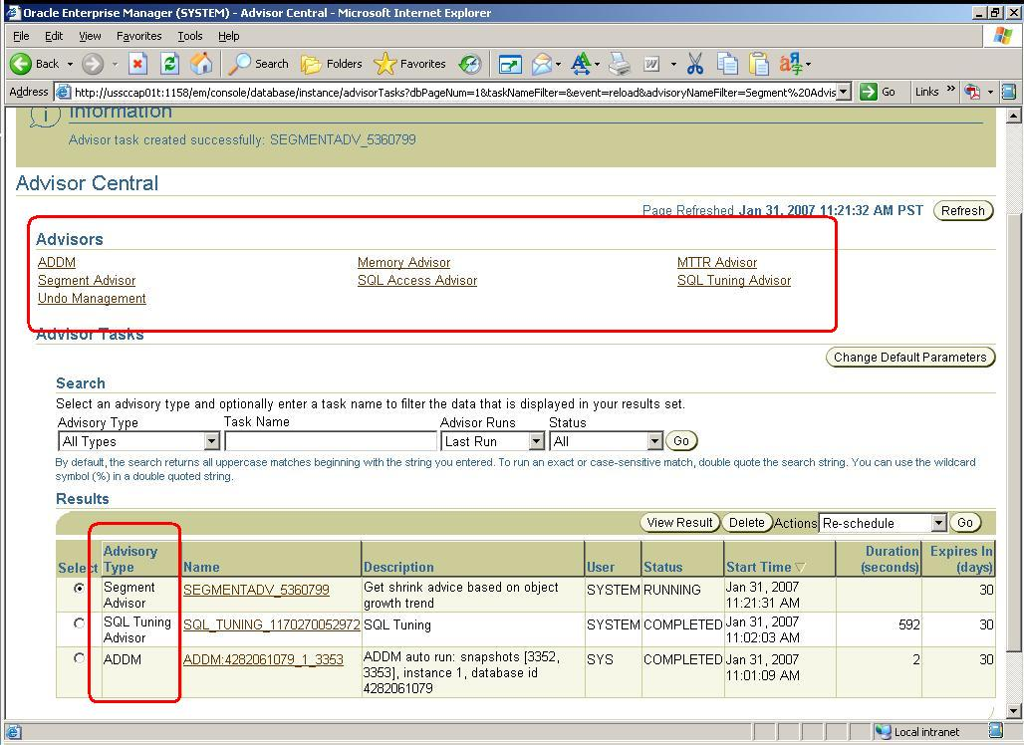

Slide 41
SQL Tuning Advisor – What?
Frontend to Automatic Tuning Optimizer
Extension (reuse) of Optimizer (CBO)
Performs “what-if” analysis
Creates an “SQL Profile” (as required)
Not restricted by “time to optimize” (_optimizer_max_permutations = 2000)
Notes:
Sub-optimal execution plans are generated even if everything is collected (object/system stats, histograms, configuration) – because this a mathematical model (e.g. information about correlated columns). The query optimizer under normal mode makes estimates about cardinality, selectivity, and cost that can sometimes be off by a significant amount resulting in poor execution plans

Slide 42
SQL Tuning Advisor – How?
The following advice is provided
  Gather missing or stale statistics
  Create new indexes
  Restructure SQL statement
  SQL profiles
SQL Profile
  collects additional information via sampling/partial execution techniques
  verifies and adjusts CBO’s estimates at runtime

Slide 43
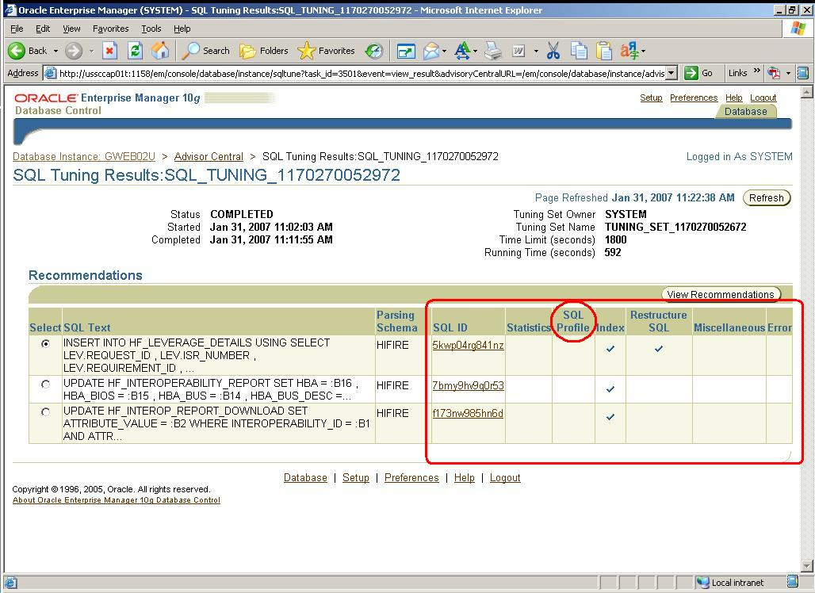

Slide 44
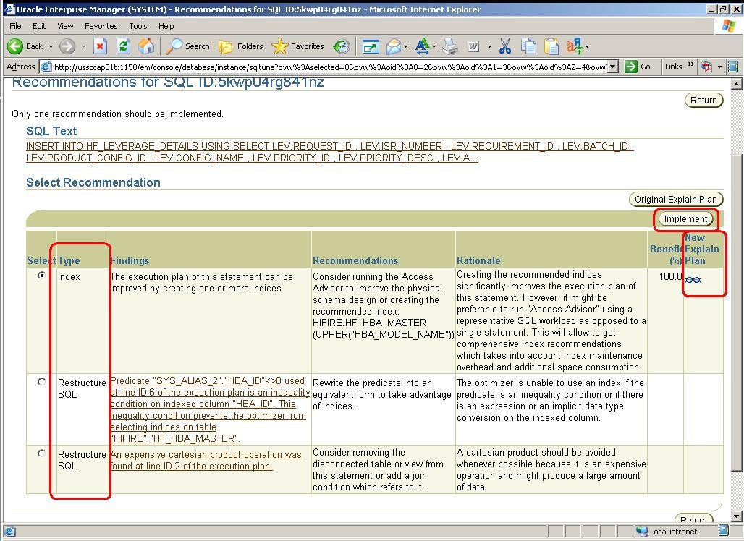

Slide 45
SQL Profiles
Similar in function to Outlines
Stored in the Data dictionary when accepted (DBA_SQL_PROFILES)
Located by hash value of SQL statement
Enabled by category so “test-and-set”
Access/manipulate – DBMS_SQLTUNE
Precedence given to Stored Outlines (??!!)
Notes:
The default active category is set through the INIT.ORA parameter SQLTUNE_CATEGORY, but can be changed with ALTER SYSTEM or ALTER SESSION. If the SQL statement contains literals, the hash value changes as well, and hence the SQL profile may be useless. 10gR2 allows substitution of literals with bind variables during the normalization phase as long no other bind variables are present in the SQL statement

Slide 46
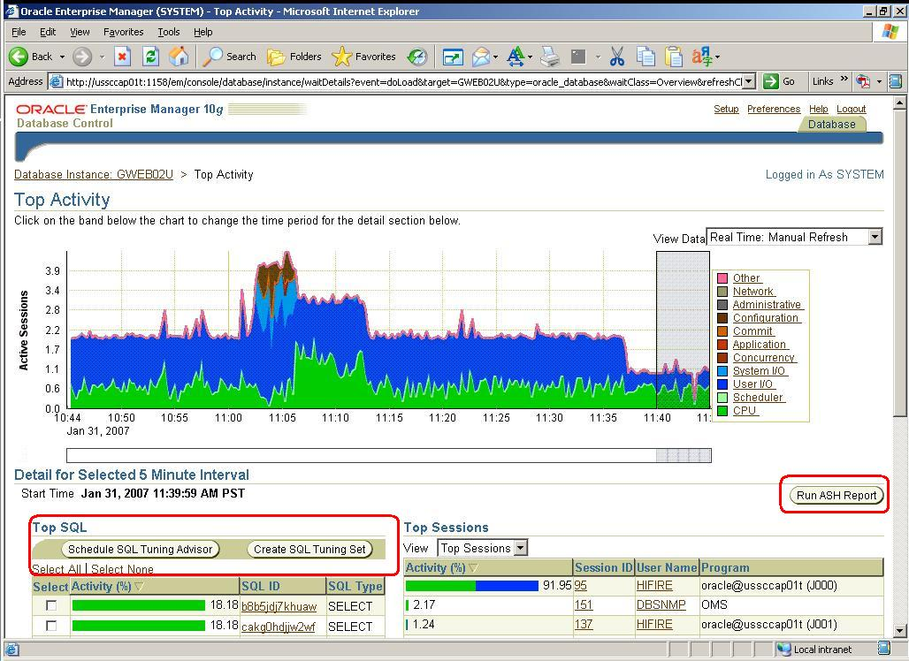

Slide 47
SQL Tuning Set
Set of SQLs to be tuned all together
DB object of SQLs and environments
User can set priority within set
Created from Top SQL (Spot/Period), ADDM -> Tuning Advisor, User-specified
Use DBMS_SQLTUNE to manipulate
Notes:
An STS includes: A set of SQL statements; Associated execution context, such as user schema, application module name and action, list of bind values, and the cursor compilation environment; Associated basic execution statistics, such as elapsed time, CPU time, buffer gets, disk reads, rows processed, cursor fetches, the number of executions, the number of complete executions, optimizer cost, and the command type; Associated execution plans and row source statistics for each SQL statement (optional)

Slide 48
SQL Access Advisor – 9i SumAdv++
Works alongside SQL Tuning Advisor
Advice on MV, Indexes, MV logs
Considers space usage vs performance
Inputs: STS, User-defined, Hypothetical
Advanced: Workload type (RO), Drop unused indexes, Filters (Top N, Module)
Notes:
User-defined workload. In this source, you use the Torch icon to choose a table in a schema that contains at least the SQL_TEXT and a USERNAME column. You can use this option to run the advisor on a pre-populated set of SQL statements.
Hypothetical load. This is the most intriguing of the choices. Basically, it enables a performance analyst to choose a schema or a set of tables that contain dimensions or primary and foreign key constraints. SQL Access Advisor can then generate recommendations for indexes and materialized views based on these relationships.

Slide 49
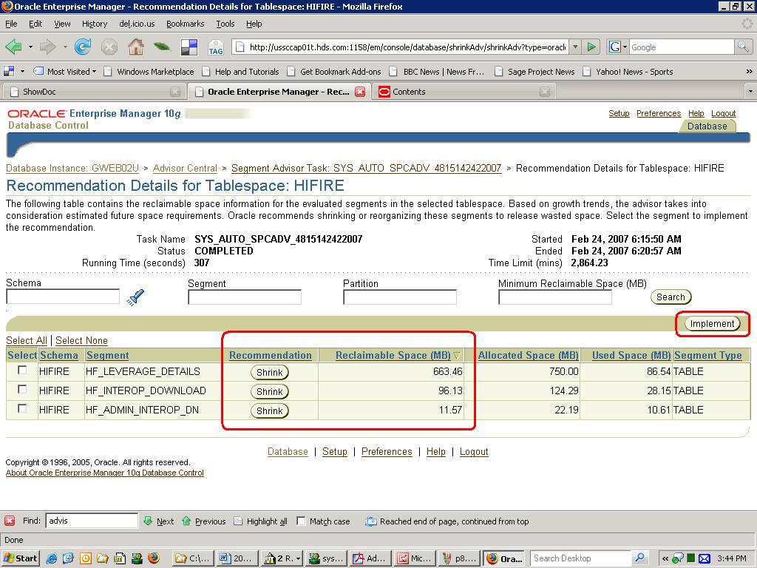
Segment Advisor
Notes:
Segment Advisor where you can get advice on segments including recommendations to shrink the object. Quick tip: Metalink Note: 242736.1 10g NEW FEATURES on SEGMENT ADVISOR

Slide 50
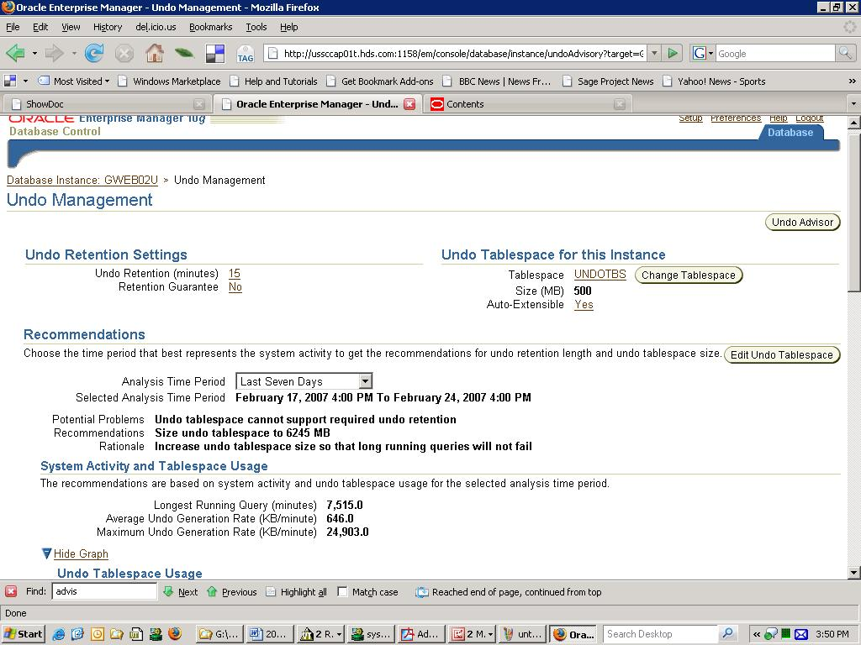
Undo Advisor
Notes:
Undo Advisor which can be used to display Undo usage over a selected period and set Undo parameters using a GUI screen. The Undo Advisor can help you determine the best size for your undo tablespace to ensure successful completion of queries.

Slide 51
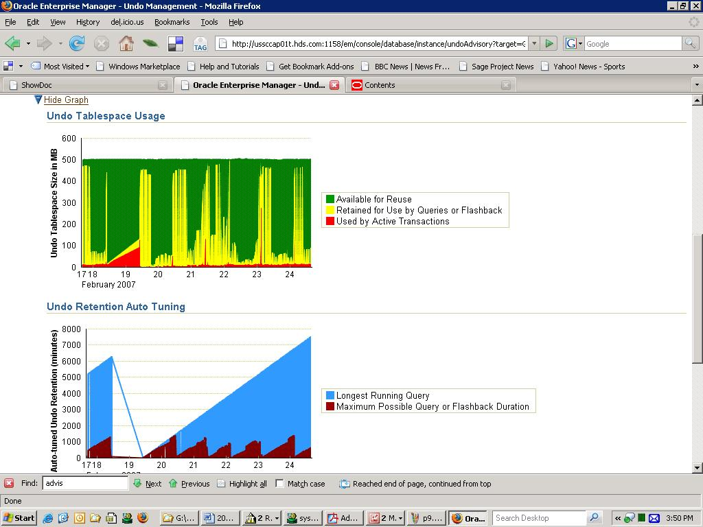
Undo Advisor

Slide 52
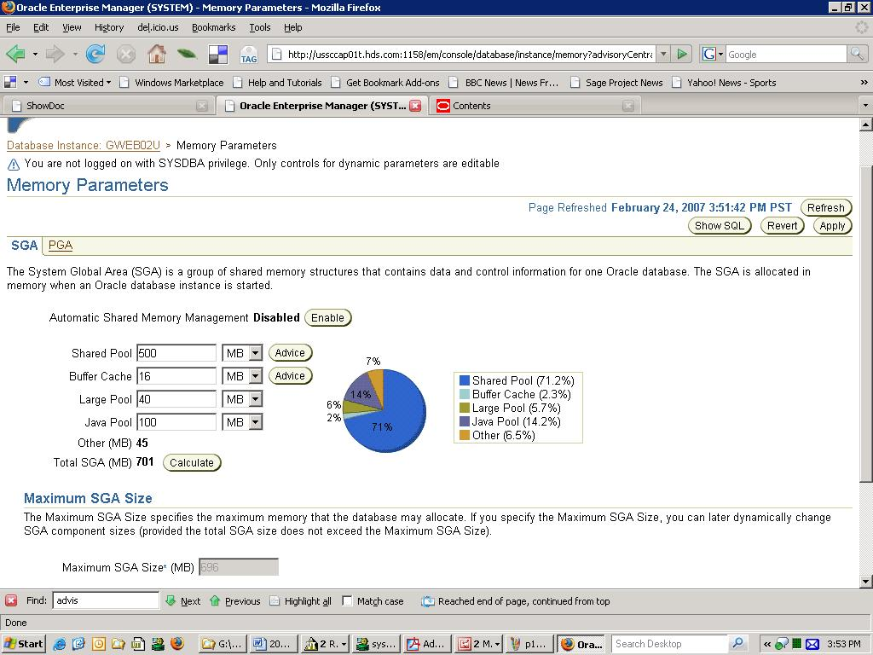
Memory Advisor
Notes:
Use the Memory Advisor to perform what-if analysis on the database performance benefits of adding or reducing physical memory to your database.

Slide 53
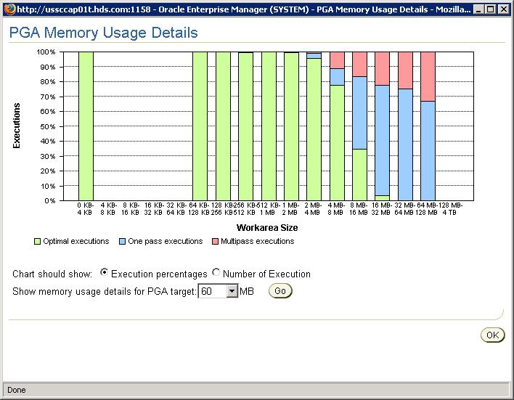
Memory Advisor

Slide 54
Avoiding Advisor Pitfalls
Out-of-the-box thinking (redesign; rethink approach)
False positives (check validity for all situations – e.g. Index non-usage)
Changing workload or environment (additional load, new code, H/W or S/W changes)

Slide 55
Metrics and SGA
Statistics views -> Cumulative counters
Metrics -> Rate of change of counters
Alerts on rate -> Server Generated Alerts (changeable via EM)
Metrics -> In memory and persisted
  Short/Long durations: 15/60 seconds
  3 mins of 15 seconds; 1 hr of 60 seconds

Slide 56
Metric Views
V$METRIC/V$SYSMETRIC (V$SYSSTAT) -> V$SYSMETRIC_HISTORY
V$EVENTMETRIC (V$SYSTEM_EVENT) -> V$EVENT_METRIC_HISTORY
V$SYSMETRIC_SUMMARY (Avg/Min/StDev)
WRH$_SYSMETRIC_SUMMARY
V$METRICNAME / V$METRICGROUP
Service metrics, Event Histogram, File/Temp Metrics
Notes:
Metric groups indicate: Event Metrics, Event Class Metrics, System Metrics Long Duration, System Metrics Short Duration, Session Metrics Long Duration, Session Metrics Short Duration, Service Metrics, File Metrics Long Duration, Tablespace Metrics Long Duration, Service Metrics (Short)

Slide 57
Server Generated Alerts
Alerts when set thresholds are reached
DBA_THRESHOLDS
V$ALERT_TYPES
Under “SYSMAN” schema; uses AQ
Fully functional monitoring system
Controlled by EM (GC/DBC)

Slide 58
Tidbits - Tracing the Advisors
_db_mttr_trace_to_alert Dump trace entries to alert
_optimizer_trace Optimizer trace parameter
_smm_trace SQL memory Manager
_stn_trace SQL tracing parameter
_xpl_trace Explain Plan tracing
“Don’t do this at home!”

Slide 59
Tidbits – Advisor Messages
$OH/rdbms/mesg/smgus.msg
“Host CPU was a bottleneck and the instance was consuming %s\% of the host CPU. All wait times will be inflated by wait for CPU.”
“The SQL statement with SQL_ID \"%s\" was found waiting for the Interested Transaction List (ITL) enqueue on the %s \"%s.%s\" with object id %s."

Slide 60
Tidbits – Statistics Aggregation
DBMS_MONITOR package
Enable stat collection & tracing at various levels (Client ID, Session, Service, Module, Action)
Boon for ConnectionPooled applications
Metalink Note: 281787.1
OTN articles

Slide 61
Where do you go from here?
Oracle DB 10g Perf. Tuning Guide
ML Note:332889.1 Issues & Best Practices
ML Note:276103.1 Perf. Tuning using Advisors & Server Manageability
Books, OTN, IOUG, …
Notes:
Metalink Note:332889.1 Oracle Database 10g Migration/Upgrade: Known Issues and Best Practices with Self-Managing Database
Metalink Note:276103.1 PERFORMANCE TUNING USING 10g ADVISORS AND MANAGEABILITY FEATURES

Slide 62
Items learnt in this session
Tuning tools in Oracle 10gR2
AWR, ADDM, ASH, Metrics, Advisors
Look “Under the hood”
Real life Examples
Next steps

Slide 63
Q & A – Feedback
Your tuning arsenal: AWR, ADDM, ASH, Metrics and Advisors
Expert Session #260
John Kanagaraj, DB Soft Inc
ora_apps_dba_y@yahoo.com
Please complete evaluation form!

